Slide 1
Self-Attention&Transformer
Instructor: Dr. Yan Yan

Slide 2
Overview
Attention
Attention is a mechanism which intuitively mimics cognitive attention. It calculates "soft" weights for each word, more precisely for its embedding, in the context window. These weights can be computed either in parallel (such as in transformers) or sequentially (such as recurrent neural networks).
Transformer
Transformer model is based on an encoder-decoder architecture. Both the encoder and decoder consist of two and three sub-layers, respectively: multi-head self-attention, a fully-connected feed forward network and — in the case of the decoder — encoder-decoder self-attention.

Slide 3
Self-Attention
Idea and Principle

Slide 4
Sophisticated Input
Input is a vector
Input is a set of vectors
Model
Scalar or Class
Model
Scalars or Classes
may change length

Slide 5
What is the output?
Each vector has a label.
The whole sequence has a label
Model
N
N
Model
Model decides the number of labels itself.
seq2seq
Model
N
Translation
N’

Slide 6
Sequence Learning
Is it possible to consider the context?
FC can consider the neighbor, but how to consider the whole inputs?
a window cover the whole sequence?
FC
Fully-connected
FC
FC
FC
FC
window
I
saw
a
saw

Slide 7
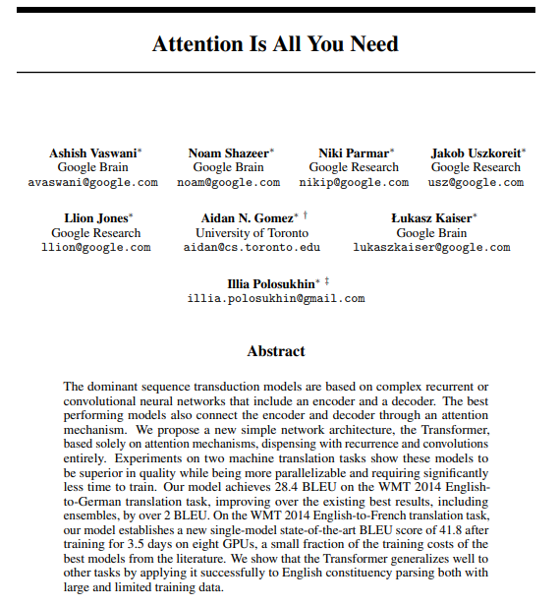

Self-attention
Attention is All You Need
FC
FC
FC
FC
with context
Self-attention
https://arxiv.org/abs/1706.03762

Slide 8


FC
FC
FC
FC
Self-attention
FC
FC
FC
FC
Self-attention
https://arxiv.org/abs/1706.03762

Slide 9








Self-attention
$$b^{1}$$
$$b^{2}$$
$$b^{3}$$
$$b^{4}$$
$$a^{1}$$
$$a^{2}$$
$$a^{3}$$
$$a^{4}$$
Can be either input or a hidden layer

Slide 10






How to get the relavance?
$$b^{1}$$
$$α$$
relevant?
$$a^{1}$$
$$a^{2}$$
$$a^{3}$$
$$a^{4}$$
Find the relevant vectors in a sequence

Slide 11
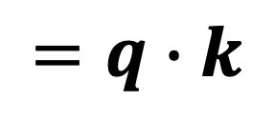



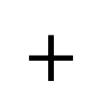
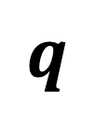






Self-attention
$$α$$
Additive
$$W$$
Dot-product
$$α$$
$$=q∙k$$
$$tanh$$
$$q$$
$$k$$
$$+$$
$$W^{q}$$
$$W^{k}$$
$$W^{q}$$
$$W^{k}$$
Notes:
Does normalization important???

Slide 12













Self-attention
$$α_{1,2}=q^{1}∙k^{2}$$
$$α_{1,3}=q^{1}∙k^{3}$$
$$α_{1,4}=q^{1}∙k^{4}$$
attention score
$$α_{1,2}$$
$$α_{1,3}$$
$$α_{1,4}$$
q¹
query
$$k^{2}$$
key
$$k^{3}$$
$$k^{4}$$
$$a^{1}$$
$$a^{2}$$
$$a^{3}$$
$$a^{4}$$
$$q^{1}=W^{q}a^{1}$$
$$k^{2}=W^{k}a^{2}$$
$$k^{3}=W^{k}a^{3}$$
$$k^{4}=W^{k}a^{4}$$

Slide 13



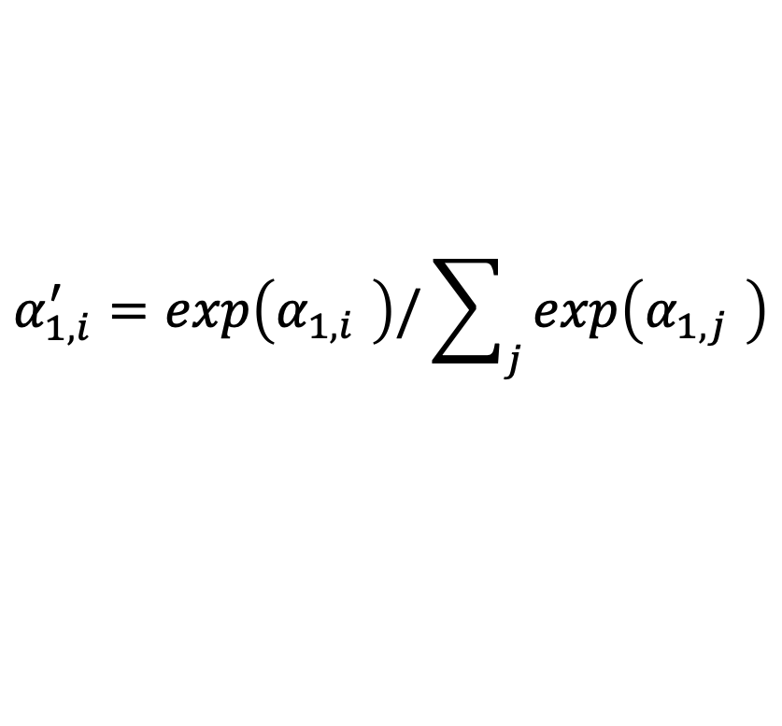





Self-attention
$$α_{1,i}^{′}=exp\left(α_{1,i} \right)/\sum_{j}{exp\left(α_{1,j} \right)}$$
$$α_{1,1}^{′}$$
$$α_{1,2}^{′}$$
$$α_{1,3}^{′}$$
$$α_{1,4}^{′}$$
Soft-max
$$α_{1,1}$$
$$α_{1,2}$$
$$α_{1,3}$$
$$α_{1,4}$$
$$q^{1}$$
$$k^{1}$$
$$k^{2}$$
$$k^{3}$$
$$k^{4}$$
$$a^{1}$$
$$a^{2}$$
$$a^{3}$$
$$a^{4}$$
$$q^{1}=W^{q}a^{1}$$
$$k^{2}=W^{k}a^{2}$$
$$k^{3}=W^{k}a^{3}$$
$$k^{4}=W^{k}a^{4}$$
$$k^{1}=W^{k}a^{1}$$

Slide 14


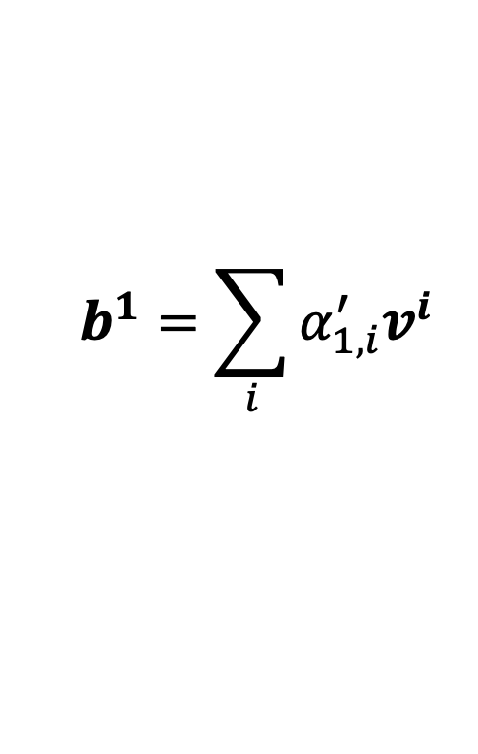






Self-attention
Extract information based on attention scores
$$b^{1}=\sum_{i}{α_{1,i}^{′}v^{i} }$$
$$b^{1}$$
$$α_{1,1}^{′}$$
$$α_{1,2}^{′}$$
$$α_{1,3}^{′}$$
$$α_{1,4}^{′}$$
$$q^{1}$$
$$k^{1}$$
$$v^{1}$$
$$k^{2}$$
$$v^{2}$$
$$k^{3}$$
$$v^{3}$$
$$k^{4}$$
$$v^{4}$$
$$a^{1}$$
$$a^{2}$$
$$a^{3}$$
$$a^{4}$$
$$v^{1}=W^{v}a^{1}$$
$$v^{2}=W^{v}a^{2}$$
$$v^{3}=W^{v}a^{3}$$
$$v^{4}=W^{v}a^{4}$$

Slide 15
Self-Attention
Matrix Calculation
Multi-head Self-attention

Slide 16







Self-attention
$$b^{2}$$
$$α_{2,1}^{′}$$
$$α_{2,2}^{′}$$
$$α_{2,3}^{′}$$
$$α_{2,4}^{′}$$
$$q^{1}$$
$$k^{1}$$
$$v^{1}$$
q²
$$k^{2}$$
$$v^{2}$$
$$q^{3}$$
$$k^{3}$$
$$v^{3}$$
$$q^{4}$$
$$k^{4}$$
$$v^{4}$$
$$a^{1}$$
$$a^{2}$$
$$a^{3}$$
$$a^{4}$$

Slide 17











Self-attention
$$q^{1}$$
$$q^{2}$$
$$q^{3}$$
$$q^{4}$$
$$a^{1}$$
$$a^{2}$$
=
$$a^{3}$$
$$q^{i}=W^{q}a^{i}$$
$$W^{q}$$
$$a^{4}$$
$$Q$$
$$I$$
$$a^{1}$$
$$a^{2}$$
$$k^{1}$$
$$a^{3}$$
$$k^{2}$$
$$a^{4}$$
$$k^{3}$$
$$k^{i}=W^{k}a^{i}$$
$$k^{4}$$
=
$$W^{k}$$
$$K$$
$$I$$
$$a^{1}$$
$$a^{2}$$
$$a^{3}$$
$$v^{1}$$
$$a^{4}$$
$$v^{2}$$
$$v^{3}$$
$$v^{i}=W^{v}a^{i}$$
$$v^{4}$$
=
$$W^{v}$$
$$V$$
$$I$$
$$q^{1}$$
$$k^{1}$$
$$v^{1}$$
$$q^{2}$$
$$k^{2}$$
$$v^{2}$$
$$q^{3}$$
$$k^{3}$$
$$v^{3}$$
$$q^{4}$$
$$k^{4}$$
$$v^{4}$$
$$a^{1}$$
$$a^{2}$$
$$a^{3}$$
$$a^{4}$$

Slide 18





Self-attention
$$α_{1,1}$$
$$k^{1}$$
$$α_{1,1}=$$
$$k^{1}$$
$$q^{1}$$
$$α_{1,2}=$$
$$k^{2}$$
$$q^{1}$$
$$α_{1,2}$$
$$k^{2}$$
$$=$$
$$q^{1}$$
$$α_{1,3}$$
$$k^{3}$$
$$α_{1,3}=$$
$$k^{3}$$
$$q^{1}$$
$$α_{1,4}=$$
$$k^{4}$$
$$q^{1}$$
$$α_{1,4}$$
$$k^{4}$$
$$α_{1,1}$$
$$α_{1,2}$$
$$α_{1,3}$$
$$α_{1,4}$$
$$q^{1}$$
$$k^{1}$$
$$v^{1}$$
$$q^{2}$$
$$k^{2}$$
$$v^{2}$$
$$q^{3}$$
$$k^{3}$$
$$v^{3}$$
$$q^{4}$$
$$k^{4}$$
$$v^{4}$$

Slide 19






























Self-attention
$$α_{1,1}$$
$$k^{1}$$
$$α_{1,1}=$$
$$k^{1}$$
$$q^{1}$$
$$α_{1,2}=$$
$$k^{2}$$
$$q^{1}$$
$$α_{1,2}$$
$$k^{2}$$
$$=$$
$$q^{1}$$
$$α_{1,3}$$
$$k^{3}$$
$$α_{1,3}=$$
$$k^{3}$$
$$q^{1}$$
$$α_{1,4}=$$
$$k^{4}$$
$$q^{1}$$
$$α_{1,4}$$
$$k^{4}$$
$$α_{2,1}$$
$$α_{2,2}$$
$$α_{2,3}$$
$$α_{2,4}$$
$$q^{1}$$
$$k^{1}$$
$$v^{1}$$
$$q^{2}$$
$$k^{2}$$
$$v^{2}$$
$$q^{3}$$
$$k^{3}$$
$$v^{3}$$
$$q^{4}$$
$$k^{4}$$
$$v^{4}$$
$$α_{1,1}^{′}$$
$$α_{2,1}^{′}$$
$$α_{3,1}^{′}$$
$$α_{4,1}^{′}$$
$$α_{1,1}$$
$$α_{2,1}$$
$$α_{3,1}$$
$$α_{4,1}$$
$$k^{1}$$
$$α_{1,2}^{′}$$
$$α_{2,2}^{′}$$
$$α_{3,2}^{′}$$
$$α_{4,2}^{′}$$
$$α_{1,2}$$
$$α_{2,2}$$
$$α_{3,2}$$
$$α_{4,2}$$
$$k^{2}$$
$$α_{1,3}^{′}$$
$$α_{2,3}^{′}$$
$$α_{3,3}^{′}$$
$$=$$
$$q^{1}$$
$$q^{2}$$
$$q^{3}$$
$$q^{4}$$
$$α_{4,3}^{′}$$
$$α_{1,3}$$
$$α_{2,3}$$
$$α_{3,3}$$
$$α_{4,3}$$
$$k^{3}$$
$$α_{1,4}^{′}$$
$$α_{2,4}^{′}$$
$$α_{3,4}^{′}$$
$$α_{4,4}^{′}$$
$$α_{1,4}$$
$$α_{2,4}$$
$$α_{3,4}$$
$$α_{4,4}$$
$$k^{4}$$
$$Q$$
$$A′$$
softmax
$$A$$
$$K^{T}$$

Slide 20















Self-attention
$$b^{1}$$
$$α_{1,1}^{′}$$
$$α_{1,2}^{′}$$
$$α_{1,3}^{′}$$
$$α_{1,4}^{′}$$
$$q^{1}$$
$$k^{1}$$
$$v^{1}$$
$$q^{2}$$
$$k^{2}$$
$$v^{2}$$
$$q^{3}$$
$$k^{3}$$
$$v^{3}$$
$$q^{4}$$
$$k^{4}$$
$$v^{4}$$
$$α_{1,1}^{′}$$
$$α_{2,1}^{′}$$
$$α_{3,1}^{′}$$
$$α_{4,1}^{′}$$
$$α_{1,2}^{′}$$
$$α_{2,2}^{′}$$
$$α_{3,2}^{′}$$
$$α_{4,2}^{′}$$
$$b^{1}$$
=
$$b^{2}$$
$$b^{3}$$
$$b^{4}$$
$$v^{1}$$
$$v^{2}$$
$$v^{3}$$
$$v^{4}$$
$$α_{1,3}^{′}$$
$$α_{2,3}^{′}$$
$$α_{3,3}^{′}$$
$$α_{4,3}^{′}$$
$$O$$
$$V$$
$$α_{1,4}^{′}$$
$$α_{3,4}^{′}$$
$$α_{2,4}^{′}$$
$$α_{4,4}^{′}$$
$$A′$$

Slide 21



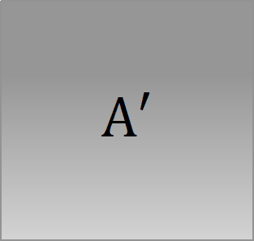







Self-attention
$$Q$$
=
$$I$$
$$W^{q}$$
$$K$$
=
$$I$$
$$W^{k}$$
$$V$$
=
$$I$$
$$W^{v}$$
Parameters learned
$$A′$$
$$A$$
=
$$Q$$
$$K^{T}$$
Attention Matrix
$$A′$$
$$O$$
=
$$V$$

Slide 22
























Multi-head Self-attention
Different types of relevance
$$b^{i,1}$$
$$q^{i,1}=W^{q,1}q^{i}$$
$$q^{i,2}=W^{q,2}q^{i}$$
$$q^{i,1}$$
$$q^{i,2}$$
$$k^{i,1}$$
$$k^{i,2}$$
$$v^{i,1}$$
$$v^{i,2}$$
$$q^{j,1}$$
$$q^{j,2}$$
$$k^{j,1}$$
$$k^{j,2}$$
$$v^{j,1}$$
$$v^{j,2}$$
$$q^{i}$$
$$k^{i}$$
$$v^{i}$$
$$q^{j}$$
$$k^{j}$$
$$v^{j}$$
$$q^{i}=W^{q}a^{i}$$
$$a^{i}$$
(2 heads as example)
$$a^{j}$$

Slide 23

Multi-head Self-attention
$$b^{i,1}$$
$$b^{i,2}$$
$$q^{i,1}=W^{q,1}q^{i}$$
$$q^{i,2}=W^{q,2}q^{i}$$
$$q^{i,1}$$
$$q^{i,2}$$
$$k^{i,1}$$
$$k^{i,2}$$
$$v^{i,1}$$
$$v^{i,2}$$
$$q^{j,1}$$
$$q^{j,2}$$
$$k^{j,1}$$
$$k^{j,2}$$
$$v^{j,1}$$
$$v^{j,2}$$
$$q^{i}$$
$$k^{i}$$
$$v^{i}$$
$$q^{j}$$
$$k^{j}$$
$$v^{j}$$
$$q^{i}=W^{q}a^{i}$$
$$a^{i}$$
(2 heads as example)
$$a^{j}$$

Slide 24
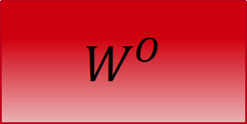

Multi-head Self-attention
$$b^{i,1}$$
$$b^{i}$$
=
$$W^{O}$$
$$b^{i,2}$$
$$q^{i,1}$$
$$q^{i,2}$$
$$k^{i,1}$$
$$k^{i,2}$$
$$v^{i,1}$$
$$v^{i,2}$$
$$q^{j,1}$$
$$q^{j,2}$$
$$k^{j,1}$$
$$k^{j,2}$$
$$v^{j,1}$$
$$v^{j,2}$$
$$q^{i}$$
$$k^{i}$$
$$v^{i}$$
$$q^{j}$$
$$k^{j}$$
$$v^{j}$$
$$q^{i}=W^{q}a^{i}$$
$$a^{i}$$
(2 heads as example)
$$a^{j}$$

Slide 25
Self- Attention
Positional Encoding
Appications

Slide 26
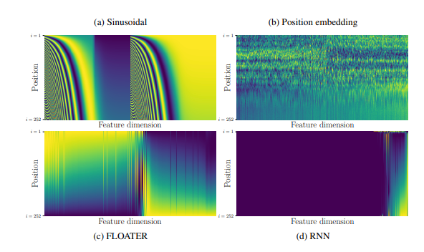

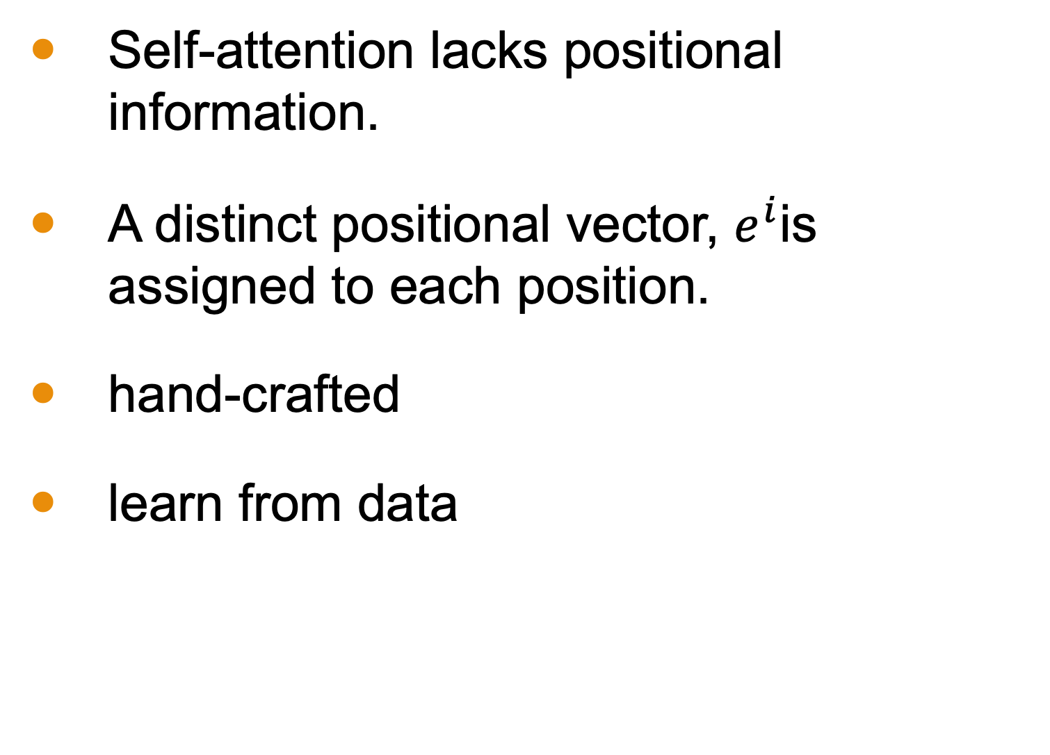
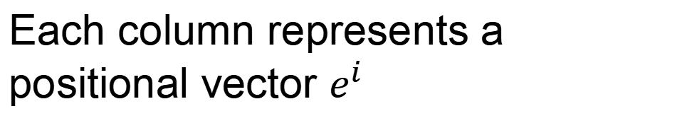
Positional Encoding
Each column represents a positional vector $e^{i}$
Self-attention lacks positional information.
A distinct positional vector, $e^{i}$is assigned to each position.
hand-crafted
learn from data
$$q^{i}$$
$$k^{i}$$
$$v^{i}$$
$$e^{i}$$
+
$$a^{i}$$
https://arxiv.org/abs/2003.09229

Slide 27
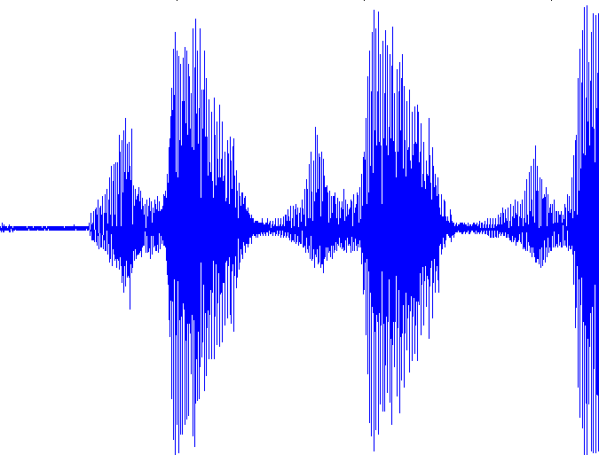

Self-attention for Speech
https://arxiv.org/abs/1910.12977
Attention in a range
Speech is a very long vector sequence.
$$b^{1}$$
$$b^{2}$$
$$b^{3}$$
$$b^{4}$$
10ms
If input sequence is length $L$
$$A′$$
$$L$$
$$a^{1}$$
$$a^{2}$$
$$a^{3}$$
$$a^{4}$$
Attention Matrix
$$L$$
Truncated Self-attention

Slide 28
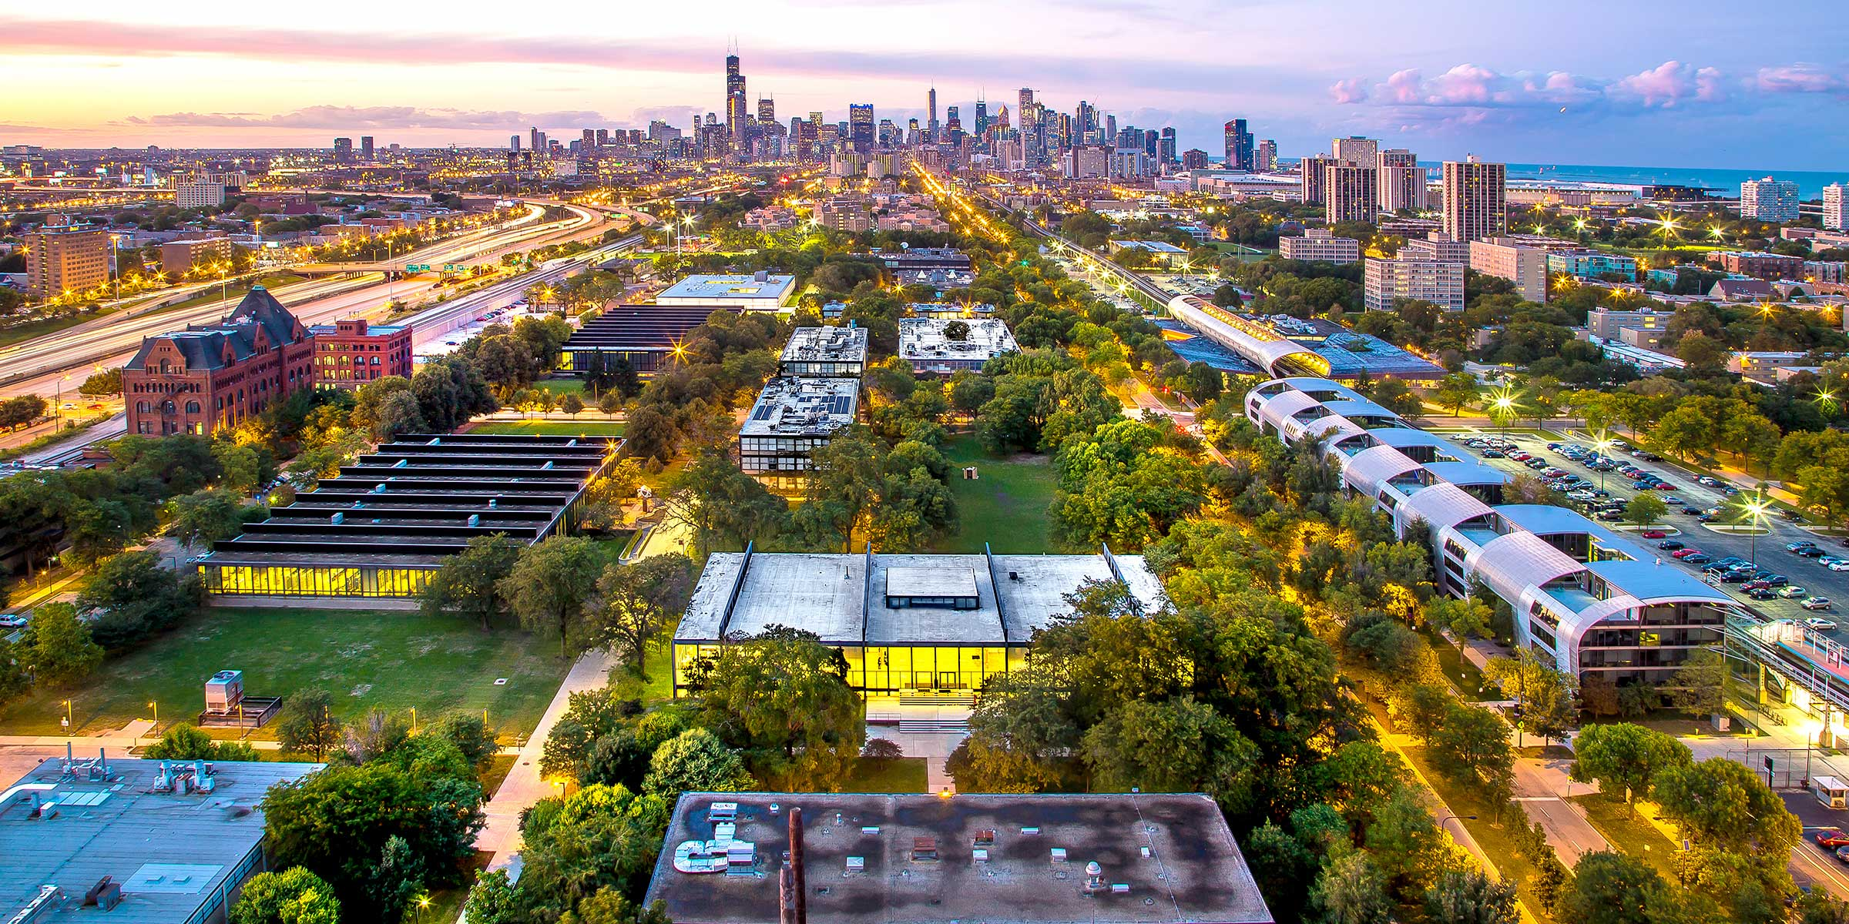
Self-attention for Image
A vector.
An image can also be viewed as a set of vectors.

Slide 29
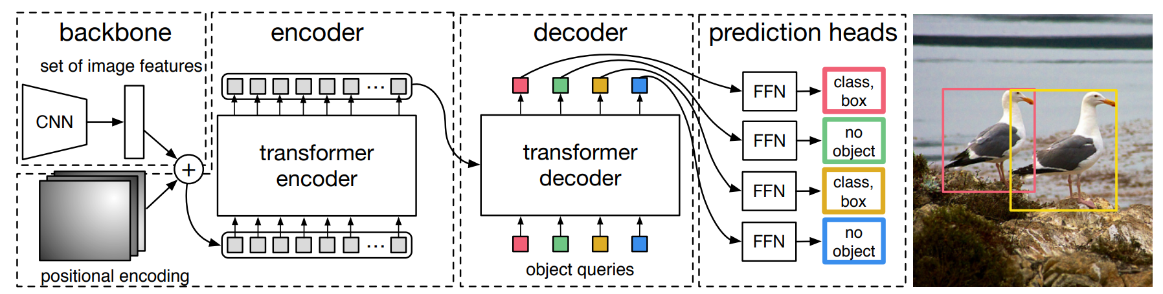
DEtection Transformer (DETR)
https://arxiv.org/abs/2005.12872
https://arxiv.org/abs/2005.12872

Slide 30
Self-attention v.s. CNN
Self-attention
CNN
1 | 0 | 0 | 0 | 0 | 1
0 | 1 | 0 | 0 | 1 | 0
0 | 0 | 1 | 1 | 0 | 0
1 | 0 | 0 | 0 | 1 | 0
0 | 1 | 0 | 0 | 1 | 0
0 | 0 | 1 | 0 | 1 | 0
CNN: self-attention that can only attends in a receptive field
CNN is simplified self-attention.
Self-attention: CNN with learnable receptive field
Self-attention is the complex version of CNN.
On the Relationship between Self-Attention and Convolutional Layers

Slide 31
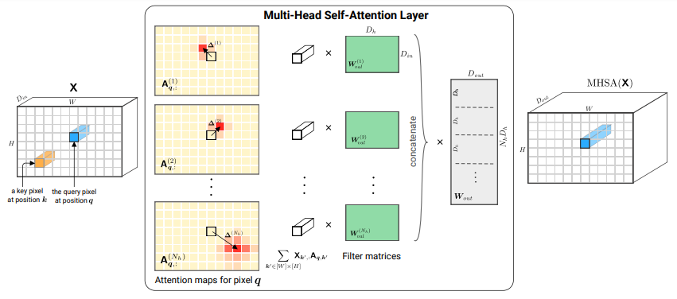
Self-attention v.s. CNN
On the Relationship between Self-Attention and Convolutional Layers
https://arxiv.org/abs/1911.03584

Slide 32

Self-attention v.s. RNN
FC
FC
FC
FC
memory
RNN
RNN
RNN
RNN
hard to consider
nonparallel
parallel
Self-attention
easy to consider
Transformers are RNNs: Fast Autoregressive Transformers with Linear Attention
https://arxiv.org/abs/2006.16236

Slide 33
Transformer
Seq2seq
Encoder

Slide 34

Sequence-to-sequence (Seq2seq)
Input a sequence, output a sequence.
The output length is determined by model.
Speech Recognition
Deep
Learning
Deep
Learning
深度学习
Machine
Translation
Speech
Translation
深度学习
(Chinese)

Slide 35
Seq2seq for Chatbot
“ Hi! How's your day going?”
Input
“Hey there!”
Seq2Seq
Reponse
[PERSON A:] Hey there!
[PERSON B:] Hi! How's your day going?
[PERSON A:] Pretty well, thanks! Just finished some work. How about you?
[PERSON B:] All good! I was about to settle in with a book. What do you do for work?
[PERSON A:] I'm a web designer. How about you? Do you work or study?
[PERSON B:] I'm actually a teacher, and I also have three kids to keep me busy. They're aged between 8 and 16.
[PERSON A:] Wow, that's quite the range. I don't have kids yet.
Training Data

Slide 36
Application of Seq2Seq
Most Natural Language Processing applications …
As long as transforming the task to Question Answering(QA)
QA can be done by seq2seq, tasks for example:
Syntactic Parsing
Multi-label Classification
Even: Obejct Detection
question/
context
Seq2Seq
answer

Slide 37
Seq2seq for Syntactic Parsing
Is it a sequence?
S
Model
Output
VP
NP
ADJV
Model
Input
deep learning is very powerful

Slide 38
(S
(NP
deep
learning
)
(VP
is
(ADJV
very
powerful
)
)
)
Seq2seq!
S
VP
NP
ADJV
deep learning is very powerful

Slide 39
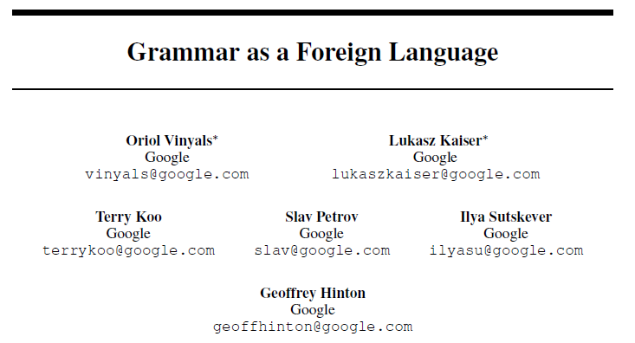
(S
(NP
deep
learning
)
(VP
is
(ADJV
very
powerful
)
)
)
https://arxiv.org/abs/1412.7449
deep learning is very powerful

Slide 40

Seq2seq for Multi-label Classification
An object can belong to multiple classes.
Class 1
Class 1
Class 3
Class 10
Class 1
Class 1
Class 3
Class 10
Class 3
Class 9
Class 3
Class 9
Class 17
Class 17
Seq2seq
Class 9
Class 7
Class 9
Class 7
Class 13
Class 13
https://arxiv.org/abs/1909.03434
https://arxiv.org/abs/1707.05495

Slide 41
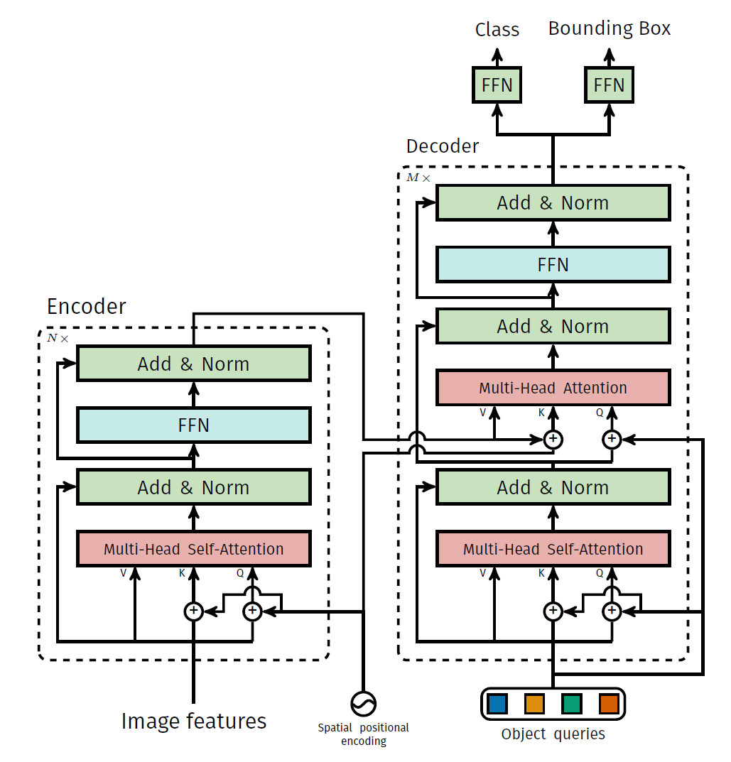
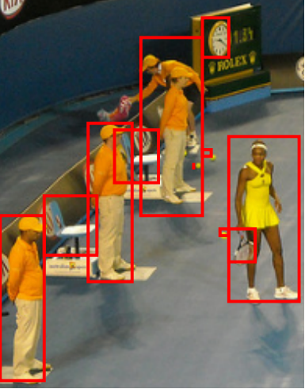
Seq2seq for Object Detection
https://arxiv.org/abs/2005.12872

Slide 42
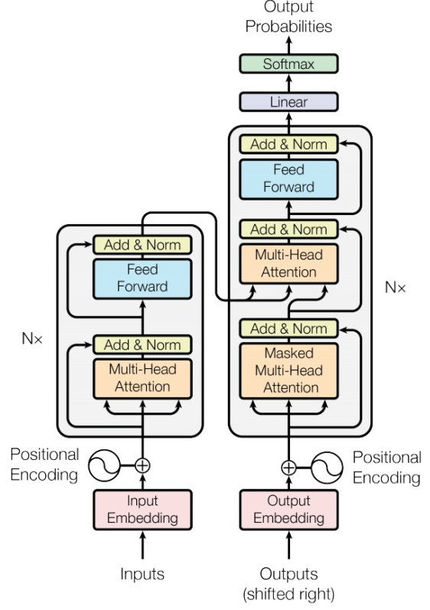
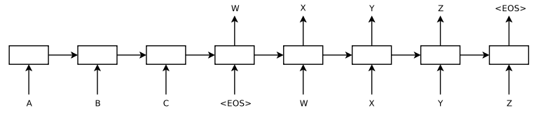
Seq2seq
output sequence
Encoder
Decoder
Input sequence
Sequence to Sequence Learning with Neural Networks
Sequence to Sequence Learning with Neural Networks
https://arxiv.org/abs/1409.3215
Transformer
https://arxiv.org/abs/1706.03762

Slide 43

Encoder
output sequence
Encoder
Decoder
Input sequence
( I love machine learning )

Slide 44
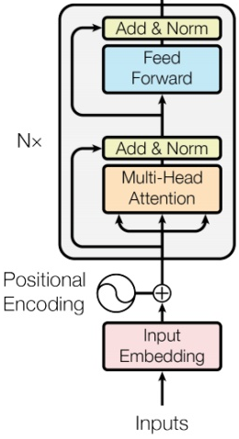








Encoder
Transformer’s Encoder
You can use RNN or CNN.
$$h^{1}$$
$$h^{2}$$
$$h^{3}$$
$$h^{4}$$
Encoder
$$x^{1}$$
$$x^{2}$$
$$x^{3}$$
$$x^{4}$$

Slide 45
$$h^{1}$$
$$h^{2}$$
$$h^{3}$$
$$h^{4}$$
Block
…
…
…
…
FC
FC
FC
FC
Block
Block
Self-attention
$$x^{1}$$
$$x^{2}$$
$$x^{3}$$
$$x^{4}$$

Slide 46






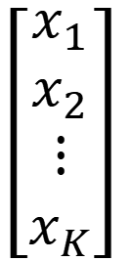


…
$$\left[\begin{aligned}x_{1}^{′} \\ x_{2}^{′} \\ ⋮ \\ x_{K}^{′}\end{aligned}\right]$$
$$x_{i}^{′}=\frac{x_{i}−m}{σ}$$
norm
norm
norm
Layer Norm
https://arxiv.org/abs/1607.06450
+
residual
$$a+b$$
$$\left[\begin{aligned}x_{1} \\ x_{2} \\ ⋮ \\ x_{K}\end{aligned}\right]$$
mean $m$
FC
standard deviation $σ$
$$b$$
+
$$a$$
Self-attention

Slide 47
$$h^{1}$$
$$h^{2}$$
$$h^{3}$$
$$h^{4}$$
Encoder
Residual
+ Layer norm
$$x^{1}$$
$$x^{2}$$
$$x^{3}$$
$$x^{4}$$

Slide 48
Transformer
Decoder
Cross attention

Slide 49
Decoder
output sequence
Encoder
Decoder
Input sequence
( I love machine learning )

Slide 50
Decoder – Autoregressive (AT)
output sequence
Encoder
Decoder
Input sequence
( I love machine learning )

Slide 51

Autoregressive
distribution
Speech Recognition as example
love | 0.0
I | 0.8
deep | 0.0
learning | 0.1
…… | ……
I
I
Size V
max
(common characters)
softmax
Encoder
Decoder
( I love machine learning )
(I love deep learning)
BEGIN (special token)
START

Slide 52
Autoregressive
I
love
deep
learning
I
learning
max
max
max
max
Encoder
Decoder
( I love machine learning )
(I love deep learning)
START
deep
START
I
love

Slide 53
Autoregressive
hate
study
I
love
deep
learning
I
learning
max
Encoder
Decoder
Decoder
Output
( I love machine learning )
(I love deep learning)
study
START
love
START
I
hate
deep

Slide 54
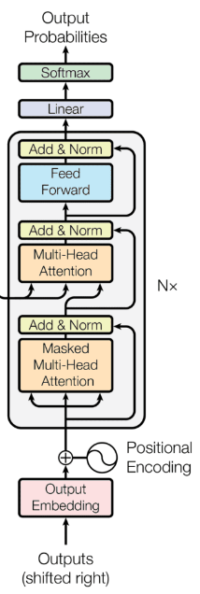
Ignore the input from the encoder here
I
love
deep
learning
I
learning
max
max
max
max
Decoder
START
I
love
machine
START
deep
START
I
love

Slide 55

Encoder
Decoder

Slide 56
Self-attention Masked Self-attention
$$b^{1}$$
$$b^{2}$$
$$b^{3}$$
$$b^{4}$$
$$a^{1}$$
$$a^{2}$$
$$a^{3}$$
$$a^{4}$$
Can be either input or a hidden layer

Slide 57
Self-attention Masked Self-attention
$$b^{2}$$
$$α_{2,1}^{′}$$
$$α_{2,2}^{′}$$
$$α_{2,3}^{′}$$
$$α_{2,4}^{′}$$
$$q^{1}$$
$$k^{1}$$
$$v^{1}$$
$$q^{2}$$
$$k^{2}$$
$$v^{2}$$
$$q^{3}$$
$$k^{3}$$
$$v^{3}$$
$$q^{4}$$
$$k^{4}$$
$$v^{4}$$
$$a^{1}$$
$$a^{2}$$
$$a^{3}$$
$$a^{4}$$
Why masked?
Consider how does decoder work

Slide 58
Autoregressive
We do not know the correct output length.
Never stop!
love
deep
learning
learning
habit
……
I
class
I
max
max
max
max
max
Encoder
Decoder
( I love machine learning )
(I love deep learning)
START
love
deep
learning
START
I
learning

Slide 59
Adding “Stop Token”
distribution
love | 0.0
I | 0.8
deep | 0.0
learning | 0.1
…… | ……
END | 0.0
Size V
(common characters)
softmax
Encoder
Decoder
( I love machine learning )
(I love deep learning)
START
START

Slide 60
Autoregressive
Stop at here!
love
deep
learning
END
I
I
learning
END
max
max
max
max
max
Encoder
Decoder
( I love machine learning )
(I love deep learning)
START
deep
learning
START
I
love
learning

Slide 61
Decoder – Non-autoregressive (NAT)
output sequence
Encoder
Decoder
Input sequence
( I love machine learning )

Slide 62
AT v.s. NAT
w₁
w₃
w₁
END
w₂
END
w₂
w₃
w₄
AT Decoder
NAT Decoder
START
w₁
w₂
w₃
START
START
START
START
How to decide the output length for NAT decoder?
Another predictor for output length
Output a very long sequence, ignore tokens after
Advantage: parallel, more stable generation
NAT is usually worse than AT

Slide 63
Encoder-Decoder
output sequence
Encoder
Decoder
Input sequence
( I love machine learning )

Slide 64
Encoder
Transformer
Cross attention
Decoder

Slide 65





FC
$$v$$
$$α_{1}^{′}$$
$$α_{2}^{′}$$
$$α_{3}^{′}$$
Cross attention
$$k^{1}$$
$$v^{1}$$
$$k^{2}$$
$$v^{2}$$
$$k^{3}$$
$$v^{3}$$
$$q$$
$$a^{1}$$
$$a^{2}$$
$$a^{3}$$
Encoder
Self-attention (Mask)
START
START

Slide 66


FC
$$v′$$
$$α_{1}^{′}$$
$$α_{2}^{′}$$
$$α_{3}^{′}$$
$$k^{1}$$
$$v^{1}$$
$$k^{2}$$
$$v^{2}$$
$$k^{3}$$
$$v^{3}$$
$$q′$$
$$a^{1}$$
$$a^{2}$$
$$a^{3}$$
Encoder
Self-attention (Mask)
START
I
START

Slide 67
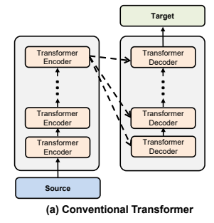

Cross Attention
https://arxiv.org/abs/2005.08081

